Slide 1
Sign Language Recognition

Slide 2
Introduction
Our project aims to create a computer application and train a model which when shown a real time video of hand gestures of American Sign Language shows the output for that particular sign in text format on the screen This contain explaintion of SPIRAL MODEL

Slide 3

Sign language is a visual language and consist of 3 major components:
Used to spell words letter by letter. | Used for the majority of communication. | Facial expressions and body position.
Word level
Sign vocabulary
Non-manual
features
Fingerspelling

Slide 4
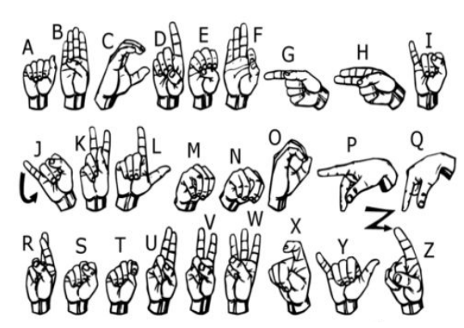
We implemented 27 symbols(A-Z, blank) of ASL in our project.

Slide 5
Methodology
It is a system of methods and principles of a project.

Slide 6
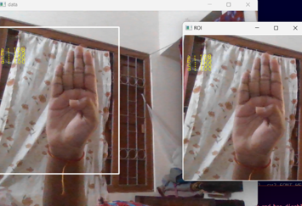
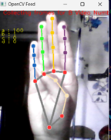
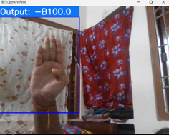
Data Collection
Data Processing
Output Screen
Sign Language Recognition

Slide 7
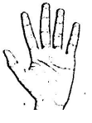
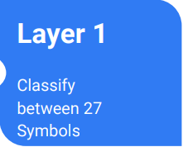
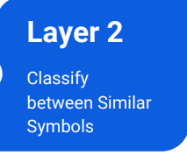
Gesture Classification

Slide 8
How it works
Signup: If you're new to our platform, sign up for an account. Provide your details to create an account and gain access to our sign language recognition system.
Login: If you already have an account, simply log in using your credentials. Enter your username and password to access your account dashboard.
Start Recording: Once logged in, navigate to the recording section and click on the "Start Recording" button. This will activate your device's camera to record the actions of a specially abled person.
Record Actions: Record the actions of the specially abled person using the camera. Ensure clear visibility of the gestures to ensure accurate recognition.

Slide 9
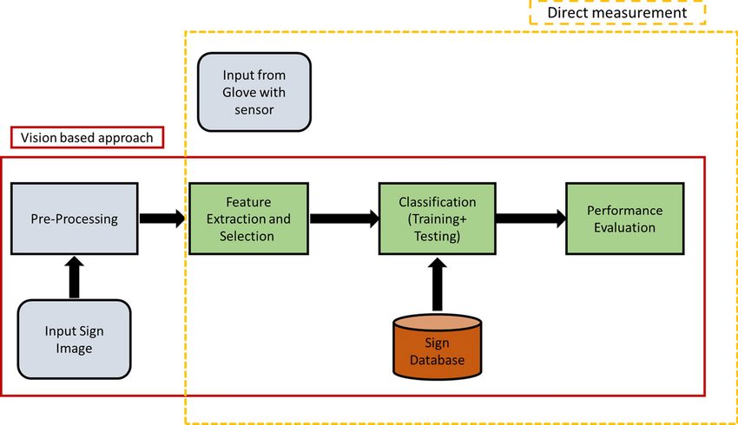
Convert to Text: After recording, our system will process the video data and analyze the sign language gestures. Using advanced algorithms, it will convert these gestures into text format.
Understandable Output: The converted text will be presented in a format easily understandable by a normal person. This enables seamless communication and comprehension of sign language gestures.
Review and Share: Review the converted text for accuracy and clarity. Once satisfied, you can share the text with others to facilitate communication and understanding.
Sign Language Recognition

Slide 10
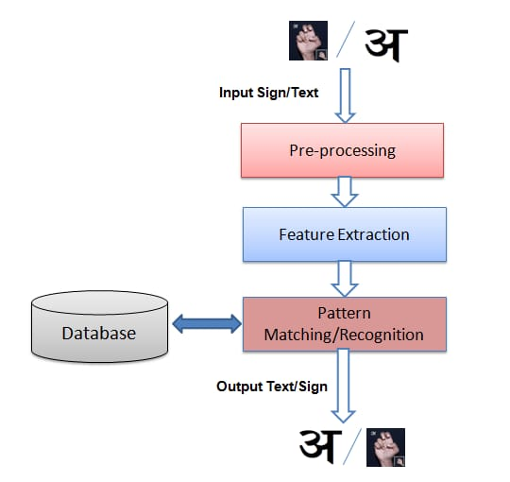

Slide 11
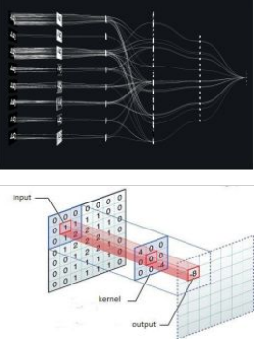
Convolutional Neural Network
CNNs consist of multiple convolutional layers each layer containing numerous “filters” which perform feature extraction.
Initially these “filters” are random and by training, the feature extraction gets better by better.
It’s primarily used for image classification

Slide 12
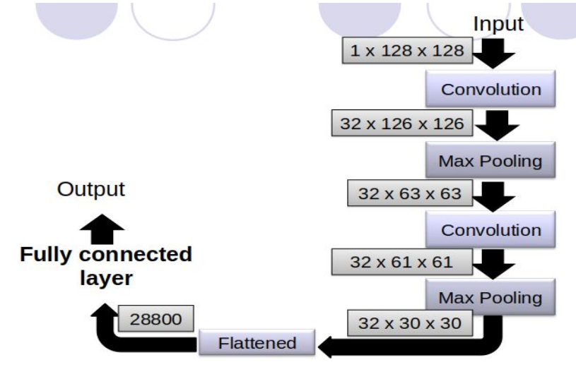
Our CNN Classifier Model

Slide 13
Finger Spelling Sentence Formation

Slide 14
Implementation
Whenever the count of a letter detected exceeds a specific value and no other letter is close to it by a threshold we print the letter and add it to the current string(In our code we kept the value as 50 and difference threshold as 20).
Otherwise we clear the current dictionary which has the count of detections of present symbol to avoid the probability of a wrong letter getting predicted.
Whenever the count of a blank(plain background) detected exceeds a specific value and if the current buffer is empty no spaces are detected.
In other case it predicts the end of word by printing a space and the current gets appended to the sentence below
Sign Language Recognition

Slide 15
Software Requirements
● Python 3.6.6
● Tensorflow 1.11.0
● OpenCV 3.4.3.18
● NumPy 1.15.3
● Matplotlib 3.0.0
● Keras 2.2.1

Slide 16
Spiral Model Phases for Sign Language Recognition
Phase 1: Planning
Identify objectives, scope, and constraints.
Define the overall goals for the recognition system (e.g., accuracy, speed, user interface).
Phase 2: Risk Analysis
Assess risks (e.g., hardware limitations, training data, model accuracy).
Analysise technological challenges and address uncertainties early.

Slide 17
Why Use the Spiral Model for a Sign Language Recognition (SLR) System?
The Spiral Model is ideal for developing a Sign Language Recognition (SLR) System due to its iterative nature and focus on risk management
.
SLR systems are complex, involving advanced technologies like machine learning and real-time processing, which require flexibility and continuous improvement.

Slide 18
Iteration 1 – First Cycle
Engineering (Development Phase)
Develop a basic prototype to capture sign language input.
Implement gesture recognition using machine learning models (e.g., CNN or RNN).
Evaluation
Conduct initial user testing and evaluate the system's performance.
Collect feedback on user experience and recognition accuracy

Slide 19
Iteration 2 – Refining the System
3
Planning
Reassess objectives based on feedback from the first iteration.
Add new features like real-time processing or multilingual support.
Risk Analysis
Reevaluate risks based on previous development and testing feedback.
Address new risks (e.g., multilingual sign language recognition).
Engineering
Implement improvements: enhance the machine learning model or use a better camera for input capture.

Slide 20
Iteration 3 – Final Refinement
Planning:-Finalize all system requirements (e.g., accuracy thresholds, user interface design).
Risk Analysis:-Ensure that remaining risks are addressed (e.g., optimizing for various lighting conditions).
Engineering:-Complete the integration of all modules (gesture recognition, text/speech output, etc.).
Evaluation:-Conduct final testing with real users, assess system performance, and validate against original requirements.

Slide 21
Conclusion
In conclusion, while sign language recognition systems have made significant progress, they still face challenges related to accuracy, adaptability, accessibility, real-time processing, and environmental factors. These limitations can impact their effectiveness in real-world applications, particularly in diverse and dynamic signing environments.
However, the future of sign language recognition systems holds promising opportunities for improvement
and innovation. Advancements in machine learning algorithms, adaptive learning techniques, real-time
feedback mechanisms, wearable technology integration, accessibility, and affordability can contribute to
overcoming these limitations.

Slide 22
By focusing on improving accuracy, adaptability, and accessibility while considering
real-time processing constraints and environmental factors, sign language recognition
systems can evolve into more effective and inclusive communication tools for individuals
who use sign language.
This journey towards enhanced functionality and usability aligns with the broader
goal of promoting inclusivity, accessibility, and effective communication for
diverse user communities.

Slide 23
THANK YOU!

